Slide 1
GRAPH APPLICATIONS
Session 23-24
Course : Z0184 -Discrete Mathematics
Effective Period : September 2017

Slide 2
On successful completion of this Course, students will be able to:
Learning Objectives
LO 1: Explain the logic of compound and quantified statements and how do to proof
LO 2: Explain and applying Set Theory, Counting method and Number Theory
LO 3: Explain Function, recursion, fuzzy set, Relations and Graph Theory
LO 4: Explain Trees & Graph theory and its application
LO 5: Explain Automata and graph its application in computer science

Slide 3
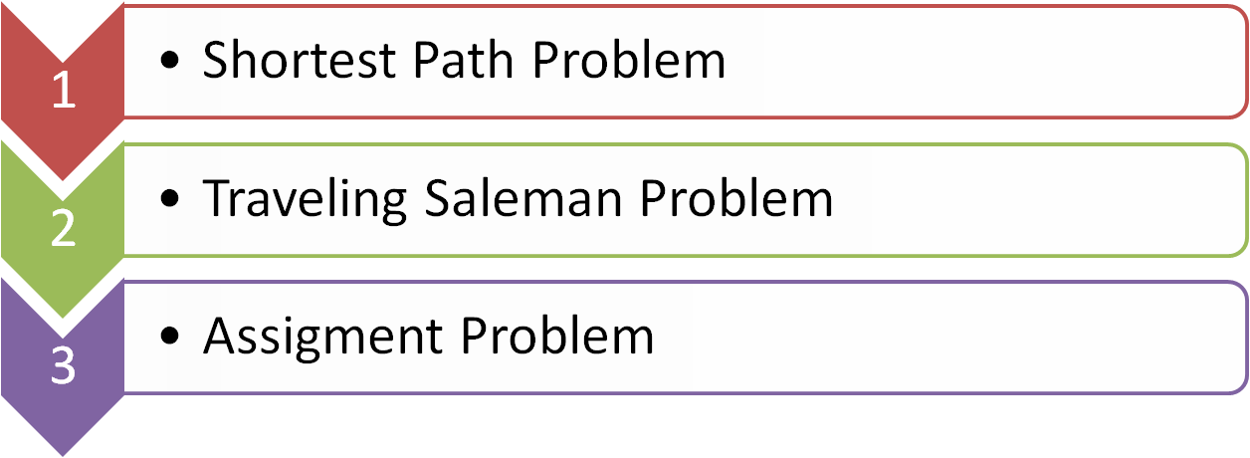

Outline
Applications in Computer Science

Slide 4
Examples of Graph Models:
Shortest Path Problem
In a directed network, we have distances on arcs ;
source node s and sink node t .
Goal: Find a shortest path from the source to the sink.
3
a
d
4
1
1
1
4
2
7
s
c
t
2
2
1
2
b
5
e

Slide 5
Traveling Salesman Problem
There are n cities. The salesman
• starts his tour from City 1,
• visits each of the cities exactly once,
• and returns to City 1.
For each pair of cities i, j there is a cost c_{ij} associated with traveling from City i to City j .
Goal: Find a minimum-cost tour.
1

Slide 6
Assignment Problem
Given: n people and n jobs
Each person can be assigned to exactly one job
Each job should be assigned to exactly one person
Person-job compatibility is given by a directed network
(e.g., having a link A → x means “person A can do job x ”)
Goal: Find an assignment of n jobs to n people
(if such an assignment exists).
Example:
people
A
B
C
D
E
jobs
x
y
z
u
v

Slide 7

Applications in computer Science (1)
Since computer science is not a concrete/centralized subject, we can introduce graph theory in many areas.
But where
Let’s see some examples…

Slide 8
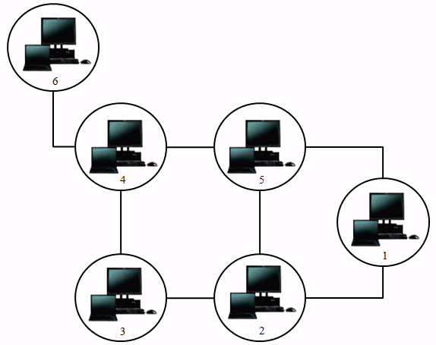
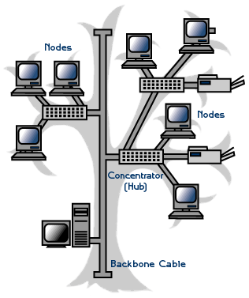
Applications in computer Science (2)
Networks: Graph theory can be used in computer networks, for security purpose or to schematize network topologies, for example.

Slide 9
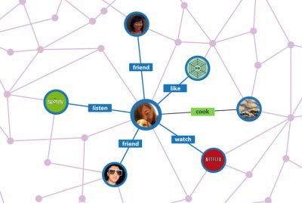
Applications in computer Science (3)
Webpage: can be represented by a direct graph. The vertices are the web pages available at the website and a directed edge from page A to page B exists if and only if A contains a link to B.
Facebook is based in graph theory

Slide 10
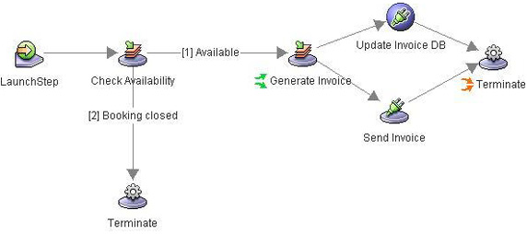
Applications in computer Science (4)
Workflow: It’s sequence of processes through which a piece of work passes from initiation to completion. Can be also represented as directed graph.

Slide 11
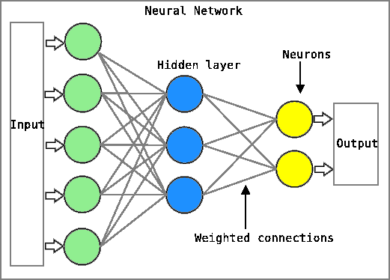
Applications in computer Science (5)
Neural Networks: A series of algorithms that attempt to identify underlying relationships in a set of data by using a process that mimics the way the human brain operates.

Slide 12
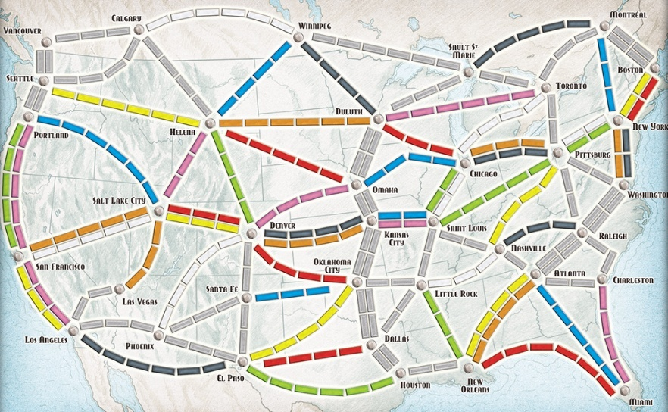
Applications in computer Science (6)
Google Maps:

Slide 13

Common problems (1)
House of Santa Claus: the house in the picture can be represented as a graph, where each vertice is a node. Try to draw a the house by yourself fallowing this rules:
You have to draw a house in one line.
You must not lift your pencil while drawing.
You must not repeat a line.

Slide 14
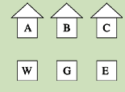
Common problems (2)
Three Houses, Three Utilities: there are three utilities (three vertices) and three houses (three vertices), and the purpose of this problem is to draw a line from each house to each facility without the lines ever crossing.

Slide 15
Conclusions
As we can see Graph Theory can be applied to several areas.
In Computer Science is mainly used to solve problems, or to represent scenarios, related with networks.

Slide 16
Reference
Susanna S.Epp. (2015). Discrete Mathematics with Applications.5th edition. Thomson Brooks/Cole. USA. ISBN: 9780534359454

